Slide 1
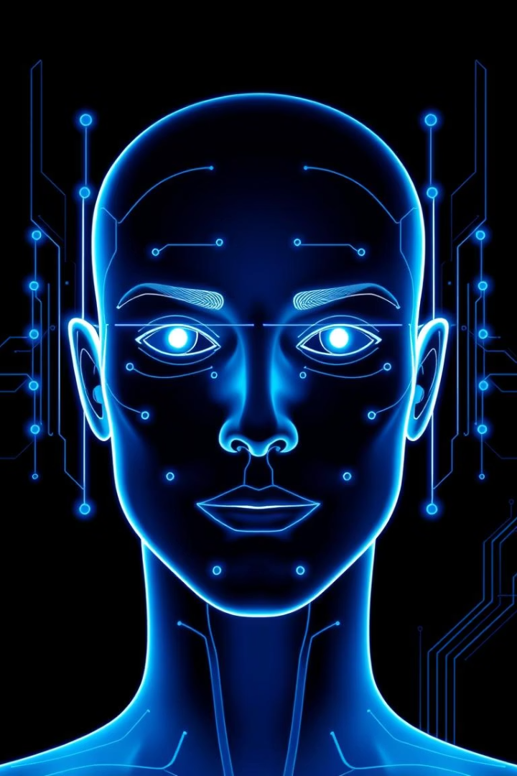
Face Recognition Attendance System
Automating Attendance Tracking with AI
Team:
Aditya Pandey 102303968
Yash Vardhan Singh 102303725
Mehul Kujur 102303712
Thapar Institute Of Engineering and Technology

Slide 2
Problem Statement
Manual System Issues
Our AI Solution
Time-consuming roll calls delay classes
AI-based facial recognition
Proxy attendance by friends
Zero physical contact, post-pandemic safe
Human errors and lost records

Slide 3
Key Objectives
Automate Attendance
High Accuracy
Prevent Fraud
Real-time face detection replaces paper
Over 85% recognition rate with LBPH
Biometric verification stops proxy attendance
User-Friendly Interface
Scalability
Simple GUI to add students and view logs
Supports 1000+ students with MySQL

Slide 4





System Workflow
Admin Adds Student
Uploads photo, roll number, department
Face Data Collection
Captures 100 images per student
Model Training
LBPH creates unique face signature
Real-Time Detection
Camera matches faces with database
Attendance Logged
Auto-saves to CSV/MySQL with timestamp

Slide 5
Technical Stack
Face Detection
Face Recognition
Database
GUI
OpenCV Haar Cascade
LBPH Algorithm: lightweight, accurate
MySQL stores roll numbers, departments
Tkinter, Python-compatible
Backend
Python + OpenCV

Slide 6
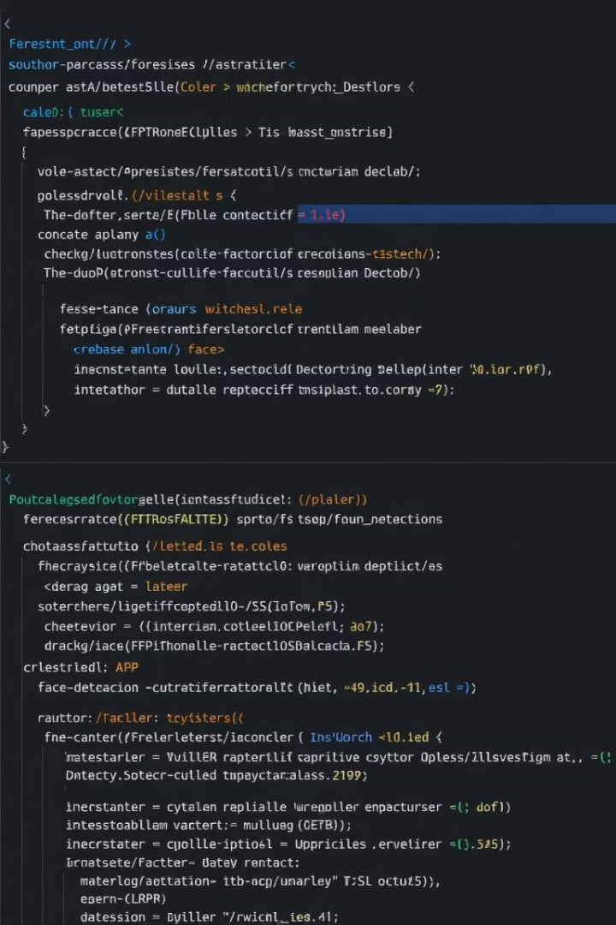
Code Highlights
Face Detection
Database Integration
detectMultiScale for real-time face detection
Insert student data into MySQL
Attendance Logging
Append attendance with timestamp to CSV

Slide 7
Dataset & Training
Dataset Structure
Training Process
Folder: data/ with user.{rollno}.{id}.jpg files
Convert images to grayscale
Extract LBPH features
Save model as classifier.xml

Slide 8
Results & Performance
Accuracy: 85-90% in good lighting
Speed: 10-15 faces/second at 720p
Metric
Traditional
Our System
Storage: MySQL handles 10,000+ records
Time/Student
30 sec
2 sec
CSV for daily backups
Proxy Risk
High
None

Slide 9

Challenges & Fixes
Challenge
Solution
Low-light recognition
Adaptive thresholding added
False positives
Increased training samples
Database lag
Batch processing implemented

Slide 10
Test Metrics
Face Detection Report:
- Precision: 0.89
- Recall: 0.92
- F1-Score: 0.90
LBPH Recognition Accuracy: 87.5%
FPS: 12.3
Noise Robustness: 8% drop (Gaussian)
Database Query: 0.32 sec

Slide 11
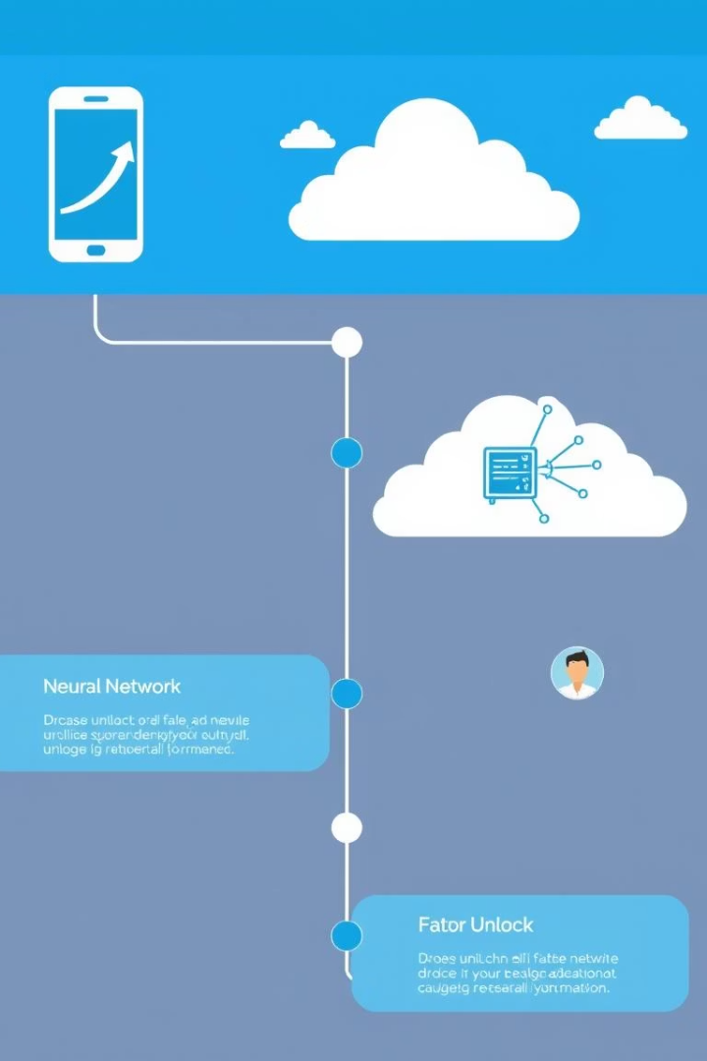
Future Scope
1
2024: Mobile App
Android/iOS attendance marking
2
2025: Cloud Sync
Live logs on AWS/Azure
3
Deep Learning Upgrade
CNN for 95%+ accuracy
4
Multi-Factor Auth
Face + RFID/NFC

